Slide 1
IEEE 802.11 WLAN STANDARDS
Name-Prateek Sagar
Roll no.- 39

Slide 2
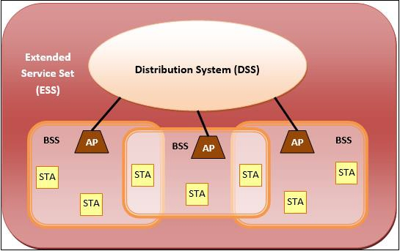
IEEE 802.11 Architecture

Slide 3
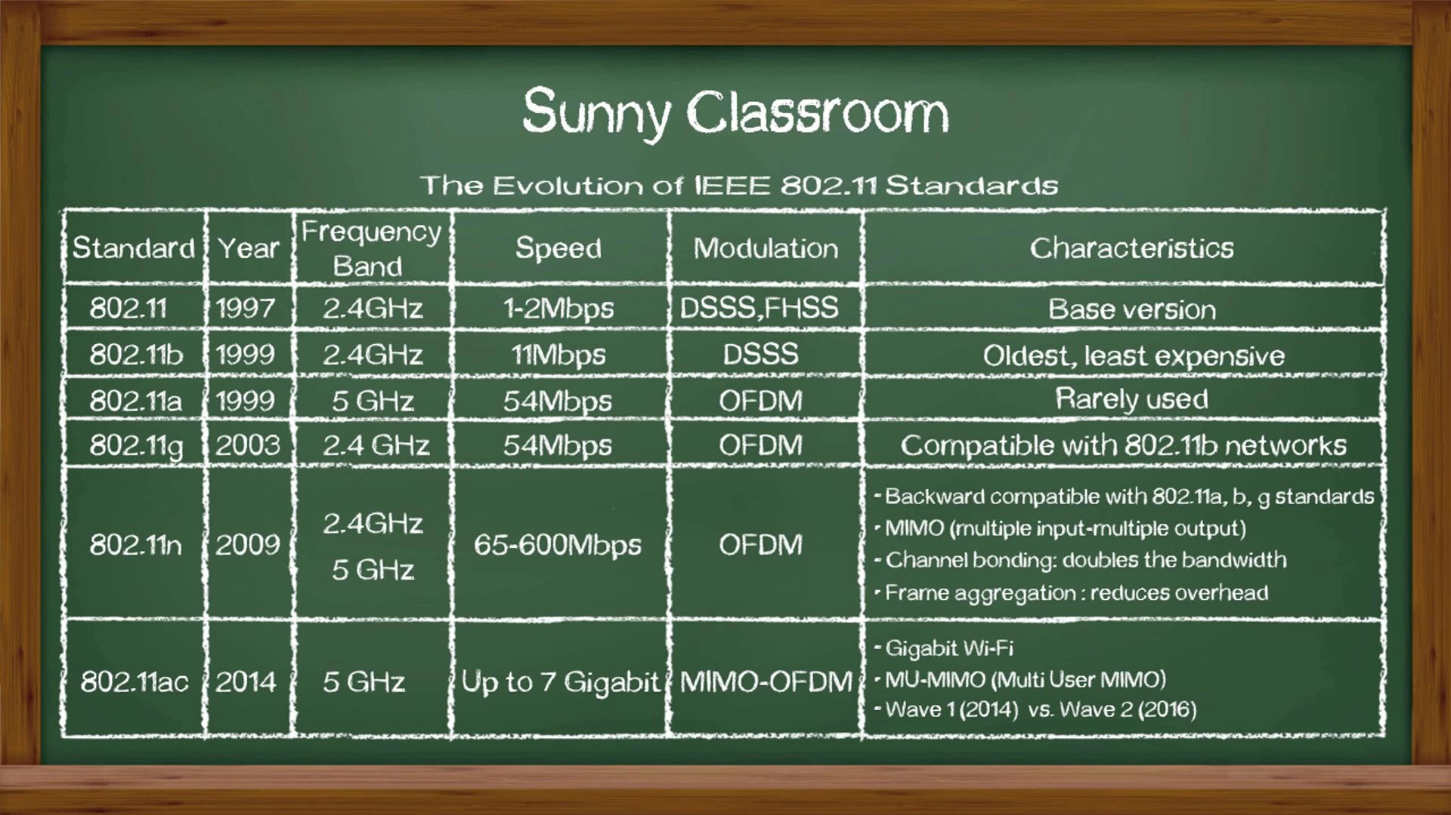
IEEE 802.11 WLAN Standards

Slide 4
THANK YOU

